Slide 1
TITLE : IoT Based Wireless Smart Board
Under the Guidance of:
Department of ISE
Acharya Institute Of Technology
Project Team Members:
Batch No:-5
Pravesh Kasaundhan (1AY15IS072)
1

Slide 2
Agenda
2
Abstract
Introduction
Detailed Survey
Problem Statement
Objectives & Methodologies of Proposed System
Requirement Specification
Design(HLD)

Slide 3
Abstract
3
Digital display board is a common sight today.Advertisement is going digital in recent days. The use of digital display boards at railway station, bus stands, educational institutions and public places are becoming an effective mode of communication in providing information to the people.
If the user wants to change the message it needs to be done using a computer and hence the person needs to be present at the location. Also the display board cannot be placed anywhere because of complex and delicate wiring. Digital smart board overcomes these drawbacks.

Slide 4
Introduction
4
Digital smart board is an automatic self enabled, highly reliable wireless electronic board.
The information can be text, images, audio and video.
It makes use of a mini computer, which is commonly termed as Raspberry Pi.
It aims at designing a LED Monitor based message display controlled through a laptop.
The main objective is to design an automatic, self-enabled highly reliable electronic notice board.

Slide 5
5
Contd…
A display connected to a server system should continuously listen for the incoming messages from user, process it and display it on LCD screen.
Message displayed will be updated every time the user sends new information.
Only authenticated people will be able to update the data to be displayed on the monitor.

Slide 6
Literature Survey 1
Title: Large Screen Wireless Notice Display System.
Published: June 2015.
Authors: Yash Teckchandani, G. Siva Perumal, Radhika Mujumdar, Sridhar Lokanathan.

Slide 7
Large Screen Wireless Notice Display System.
Methodology:
Here GSM network is being used, the notice can be sent from practically any location on the globe and it will be displayed on the screen.
The Global System for Mobile Communications (GSM) network is digital. This makes it immune to noise. Also, GSM networks are relatively free of errors.
Summary:
The use of GSM modem limits the application to text messages.
The use of GSM limits the range of connectivity to the remote location.

Slide 8
Literature Survey 2
Title: GSM Based Wireless Electronic Notice Board Display through ARM7 and LED.
Published: May 2016.
Author: P. Sampath Kumar, V. Priyanka, Lakshmi Surekha, Y. Harish Reddy.

Slide 9
GSM Based Wireless Electronic Notice Board Display:
Methodology:
Author had proposed a system which will enable people to wirelessly transmit notices on a notice board using GSM.
The project mainly focuses on transmission of textual data through air interface by the use of GSM through asynchronous serial communication.
Summary:
The SMS is deleted from the SIM each time it is read, thus making room for the next SMS.
The major constraints incorporated are the use of „*‟ as the termination character of the SMS and the display of one SMS as a time.

Slide 10
Literature Survey 3
Title: Wireless Electronic Notice Board Using Raspberry Pi 3.
Published: June 2017.
Author: Er. G. Jalalu, Er. Polepogu Rajesh.

Slide 11
Wireless Electronic Notice Board Using Raspberry Pi 3:
Methodology:
Author used the laptop as transmitter to send the notices and Raspberry Pi 3 model is used as receiver.
When both the transmitter and receiver are connected to the same network, then the notices are displayed on the monitor.
They are displayed one after the other after 5 seconds time gap.
Summary:
The proposed system limits the client and server to be confined to a single network.
The use of Transmitter and Receiver limits the range of connectivity to the remote location.

Slide 12
Literature Survey 4
Title: An IoT Based Web Page Controlled Digital Notice Board.
Published: August 2017.
Author: P. Bhaskara Chary, Dr. T. Srinivasulu.

Slide 13
An IOT Based Web Page Controlled Digital Notice Board:
Methodology:
Receiver section contains Microcontroller, LCD display and GSM800L GSM module. Microcontroller is programmed by using embedded C language in KEIL software. A sim is inserted into the GSM module, once the power supply on AT commands executes one by one.
The GSM800L module will download the data from the web server and transmit to the microcontroller block. Now the microcontroller fetches and executes the information from the GSM module and displays in the LCD.
Summary:
This proposed system uses the very old and slow technology i.e. C language in KEIL software.

Slide 14
Literature Survey 5
Title: IoT based web-controlled notice board.
Published: April 2018.
Author: Divyashree M, Harinag Prasad S, Sandeep G T, Bhavya S N, Poornima S.

Slide 15
IoT based web-controlled notice board:
Methodology:
Client: Authorized user & Server: Raspberry pi. Users enters a password to connect to raspberry pi.
A TCP client is made on PC which interfaces with TCP server. When a connection is established the client sends message to server. The text file is prepared by another program which displays the text on LCD.
Summary:
Remote activities allow administrations, for example, long-go interchanges, that are inconceivable or illogical to execute with the utilization of wires.

Slide 16
Problem statement
In the existing system, the developers have used old technologies, such as GSM, Transmitter/Receiver which uses C language in Keil Software. These technologies are inefficient and not reliable.
Hence to overcome these drawbacks, we are using modern technologies such as IOT with wireless based remote access network

Slide 17
Objectives and methodologies of proposed system
Module 1: Configuration
Objective: In this module , we will be configuring Raspberry Pi , Router and Dataplicity.
Methodology:
Using Python: The python library will be used to configure the Raspberry Pi. The python libraries such as numpy ,pandas, requests will be used to write the python scripts.

Slide 18
Module 2: Setup
Objectives: In this module, we will be setting up the environment for the next phase.
Methodology:
This phase involves the following method:
Getting the digital board ready by providing the power supply and connecting it to the network.
Install Raspbian OS on raspberry pi and set it ready for use.
Register yourself and the device online with Dataplicity.

Slide 19
Module 3: Assembly
Objectives: In this module, we will be assembling all the components configured and set in the previous phase.
Methodology:
Connect the laptop to internet either through Wi-Fi/LAN.
The Raspberry Pi will be connected to the same network as your laptop through the wi-fi adapter present in Raspberry Pi.
The raspberry Pi will be connected through the HDMI port to the Digital screen.

Slide 20
Module 4: Deployment
Objective: In this module, we will be deploying the system.
Methodology:
The user will push the information or data to be displayed through the Dataplicity portal.
This information through the internet will be sent to the raspberry pi which is present in the remote location.
The raspberry pi will push the same data onto the smart board which will display this data.

Slide 21
DESIGN
21tttt
Module 1:
Configuration
Module 2:
Setup
Module 3:
Assembly
Module 4:
Deployment

Slide 22
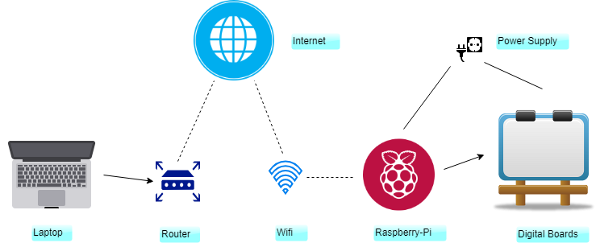
Overview
Contd..

Slide 23
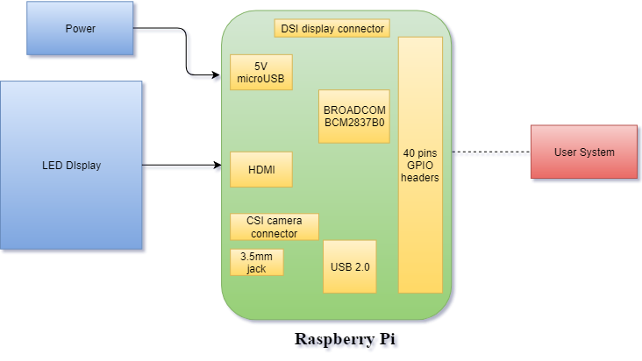
High Level Design(HLD):
Contd..

Slide 24
REQUIREMENT SPECIFICATION
Windows
Raspberry Pi 3A+
Router
Laptop
LCD Screen
Dataplicity
Raspbian

Slide 25
References
25
Large Screen Wireless Notice Display System by Yash Teckchandani, G. Siva Perumal, Radhika Mujumdar, Sridhar Lokanathan [June 2015].
GSM Based Wireless Electronic Notice Board Display through ARM7 and LED by P. Sampath Kumar, V. Priyanka, Lakshmi Surekha, Y. Harish Reddy [May 2016].
Wireless Electronic Notice Board Using Raspberry Pi 3. by Er. G. Jalalu, Er. Polepogu Rajesh [June 2017].
An IOT Based Web Page Controlled Digital Notice Board by P. Bhaskara Chary, Dr. T. Srinivasulu [August 2017].

Slide 26
Contd..
IoT based web-controlled notice board by Divyashree M, Harinag Prasad S, Sandeep G T, Bhavya S N, Poornima S [April 2018].
www.python.org for details on python programming.
www.raspberrypi.org for details on Raspberry Pi.
www.raspbian.org for details on Raspbian OS.
www.dataplicity.com for details on Dataplicity.

Slide 27
Any Questions?
27

